Slide 1

Exploratory Data Analysis (EDA) & Business Intelligence
Data Analytics Internship — Task 2
ApexPlanet Pipeline Execution
By : Fatimah Adnan

Slide 2
Exploratory Data Analysis (EDA) & Business Intelligence
Transforming 1,000 raw sales records into actionable business insights.

Slide 3






Core Task Objectives
Descriptive Statistics
SQL Aggregations
KPI Mock-up
Executing targeted data queries to pull out vital revenue markers and answers directly from the dataset.
Designing a static dashboard framework to structure critical baseline metrics cleanly for leadership review.
Calculating summaries and trends to understand the data's fundamental distribution and layout.

Slide 4
Dataset Integrity Summary
1,000
Processed Transactions
Data Posture Check
Following the initialization steps, the data files preserve strict column accuracy. Missing entry vectors across fields like `Age` and `City` have been handled cleanly, paving the way for valid correlation models.

Slide 5
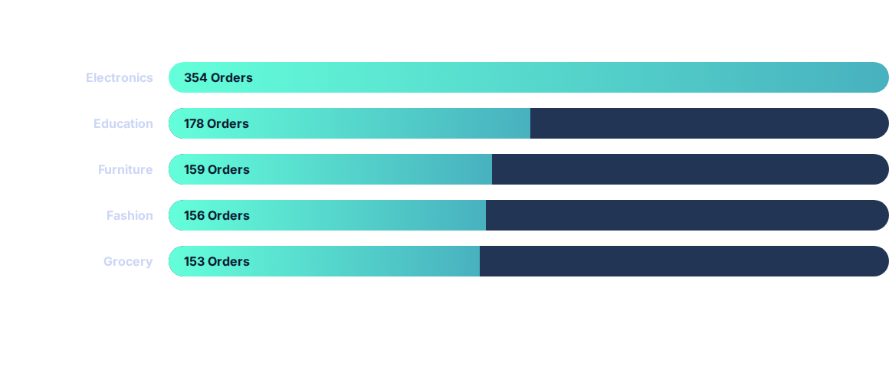
Univariate Analysis: Category Lead
**Key Insight:** Electronics holds the clear volume advantage, mapping out over **35%** of all recorded user trends.

Slide 6


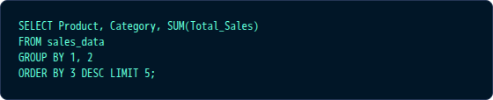
SQL Business Intelligence
Query: Identifying Top Revenue Drivers.
Laptop: $25.44M Revenue
Mobile: $25.33M Revenue

Slide 7


Average Order Value (AOV) Insights
Youth
Senior
Middle Age
Young Adult
$144.3k
$144.2k
$139.2k
$135.9k
Highest AOV
High Margin
Steady Spend
Vol. Growth
The analysis reveals that **demographic extremes (Youth & Seniors)** actually contribute the highest value per transaction, identifying a key opportunity for premium marketing targeting.

Slide 8
VIP Customer Spotlight (LTV)
Rank | Customer Name | ID | Lifetime Value ($)
1 | Customer_254 | CUST2062 | $493,677.50
2 | Customer_200 | CUST4706 | $492,174.10
3 | Customer_36 | CUST1711 | $490,866.40
These high-value individuals represent our **Tier 1 Loyalists**. Retaining these customers is critical for maintaining high annual revenue ceilings.

Slide 9

Monthly Revenue Trends
Jan '25Mar (Peak)JunSepDec '25
**March 2025** peaked at **$13.06M**, showing a significant seasonal spike in purchasing activity.

Slide 10




Static Dashboard Proposal
TOTAL REVENUE
TOTAL ORDERS
AVG BASKET
TOP REGION
$159.4M
1,000
$159k
Patna
Revenue by Category
Regional Share
This dashboard mock-up represents the critical KPIs proposed for tracking sales health moving forward.

Slide 11


Any Questions?
Exploratory Data Analysis (EDA) & Business Intelligence — Task 2 Complete.
http://www.linkedin.com/in/fatimah-adnan-02118a325
https://github.com/fatimahadnan230/ApexPlanet-Data-Analytics-Internship/tree/main

